Slide 1




Performance Benchmarking of YOLO Architectures for Real-Time Object Detection
A Comparative Study of YOLOv5, YOLOv8 and YOLOv11
Team Members
Beyza GÜLER
Ramazan YILDIZ
Abldelrahman MOHAMED
Department
Computer Engineering
Ataturk University

Slide 2


Presentation Outline
Introduction & Problem Statement
Motivation and objectives
Background Concepts
Object detection fundamentals
1
2
YOLO Architecture & Selection
Model variants and advantages
Dataset & Annotation Format
Roboflow fruits detection dataset
3
4
Methodology & Training Pipeline
Implementation and configuration
Experimental Results
YOLOv5, YOLOv8, YOLOv11
performance
5
6
Comprehensive Analysis
Model Comparison & Analysis
Benchmarking and insights
Deployment & Web Application
Streamlit-based interface
7
8
Challenges & Future Work
Limitations and recommendations
9

Slide 3







Team & Roles
Beyza GÜLER
YOLOv11 Specialist & Reporting
Ramazan YILDIZ
AI Project Planning & Research
Abdelrahman MOHAMED
YOLOv5 Specialist & Web Developer
Trained YOLOv11 model
Project initialization & preparation
Analyzed YOLOv11 metric results
Research & dataset preparation
Trained YOLOv5 model
Technical documentation
Trained YOLOv8m & YOLOv8n models
Analyzed YOLOv5 metrics
Reporting and analysis
Developed web interface
Model comparison analysis
OpenCV preprocessing & visualization
Focus: Project coordination & model benchmarking
Focus: Model evaluation & metrics analysis
Focus: Web deployment & system integration

Slide 4

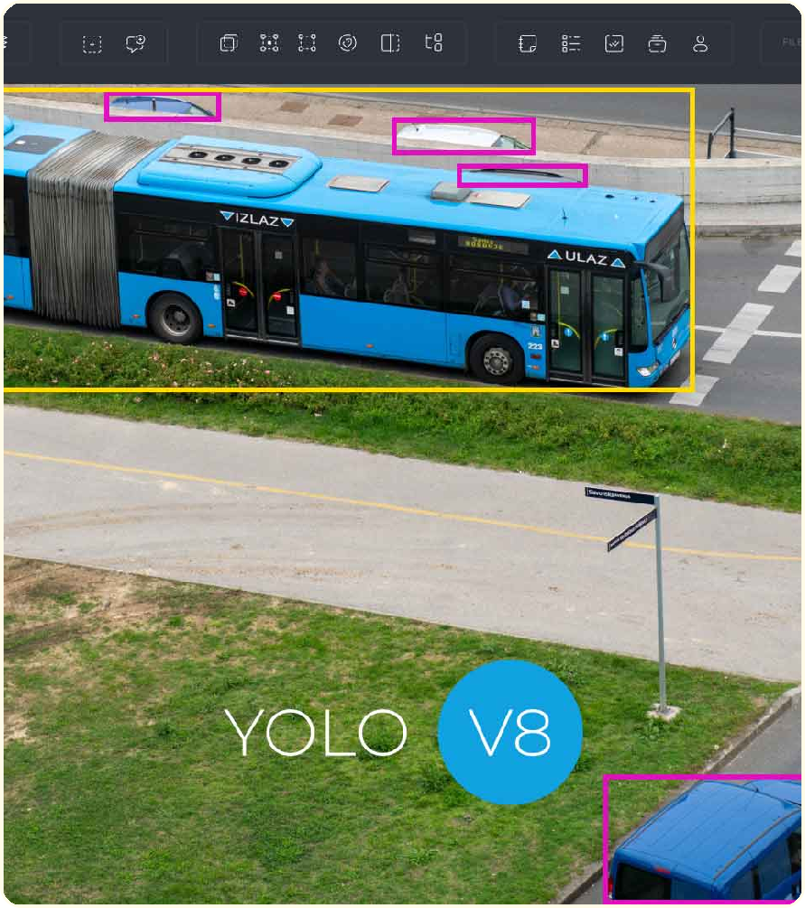




Abstract
This project presents a comprehensive real-time object detection system based on YOLO architectures, with focus on performance benchmarking across multiple model generations.
Three Model Architectures
Benchmarking YOLOv5, YOLOv8, and YOLOv11 variants
Custom Fine-Tuning
Pre-trained weights adapted to Roboflow fruit dataset
Streamlit Deployment
Interactive web interface for live detection
Key Metrics
Accuracy (mAP), Processing Speed (FPS), Real-time Performance
Real-time detection with bounding boxes

Slide 5








Problem Statement
The Challenge of Real-Time Object Detection
Key Application Areas
Speed vs Accuracy Tradeoff
High accuracy models often sacrifice real-time performance
Limited Accessibility
Complex deployment pipelines hinder adoption
Autonomous Driving
Security Systems
Hardware Constraints
GPU availability and computational cost barriers
Smart Cities
Industrial Automation
"Our goal: Build a balanced system that achieves ~30 FPS while maintaining high detection accuracy"
Real-time detection critical for safety & efficiency

Slide 6








Goals & Success Criteria
Project Objectives
Real-Time Performance
Process video at minimum 30 FPS
High Detection Accuracy
Achieve competitive mAP scores
Success Metrics
Training Stability
30+ FPS
mAP > 0.75
Model Convergence
Real-Time Inference
User-Friendly Interface Accessible web-based detection
Scalable Architecture Extensible for future enhancements
Web Deployment
Easy to Use
Modular Design
Continuous Improvement
Optimizing accuracy & speed

Slide 7



Background: Object Detection vs Classification
Image Classification
Single Label Assignment
Assigns ONE category to the entire image
Example: "cat" for an image containing a cat
Object Detection
Multiple Objects + Localization
Detects, classifies, and locates ALL objects
Example: "cat (box 1), dog (box 2), person (box 3)"
Simpler task
Single prediction
High computational efficiency
Bounding box regression
Multiple predictions Real-time requirement

Slide 8










Why YOLO?
YOLO: You Only Look Once
Single-Stage Detector
Detection in ONE forward pass through the network
Proven Track Record
Real-Time Performance
Widely Adopted
Industry standard for real-time detection
Achieves high FPS rates suitable for video streams
Accuracy-Speed Balance
Optimal tradeoff for most applications
Multiple Model Sizes
Easy Integration
Simple deployment with PyTorch
Nano, Small, Medium, Large variants for different needs
Strong Community Support
Extensive documentation, pre-trained weights, and tutorials
Battle-Tested Architecture
YOLOv5 → YOLOv8 → YOLOv11 evolution

Slide 9
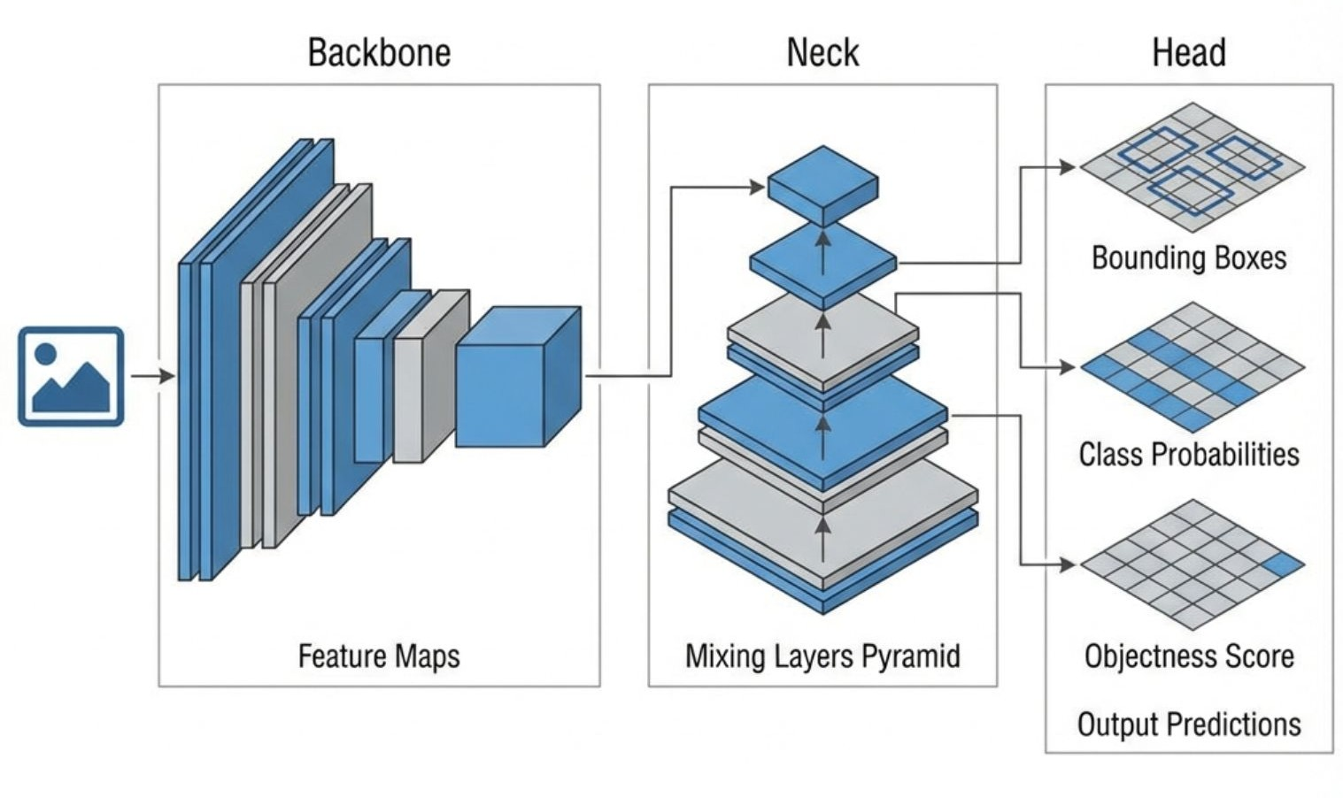



YOLO Architecture
Backbone
Feature extraction from input images
Neck
Multi-scale feature aggregation
Head
Bounding box & class prediction
Input → Backbone → Neck → Head → Detection

Slide 10





Dataset Overview
Roboflow Fruits Detection Dataset
Total Images
Fruit Classes
Format
2,974
9
YOLO
Data Distribution
Training Set
2,697 (91%)
Validation Set
187 (6%)
Test Set
90 (3%)
Pre-labeled dataset for fast model fine-tuning

Slide 11




Annotation Format
YOLO Format
Example Annotation
0 0.71 0.84 0.15 0.23
Label File Format
Each line represents one object:
class_id x_center y_center width height
Class ID
Center X
Center Y
Width
Height
0
0.71
0.84
0.15
0.23
Apple
Horizontal
Vertical
Box Width
Box Height
All values normalized to [0, 1]
Coordinates are relative to image dimensions

Slide 12

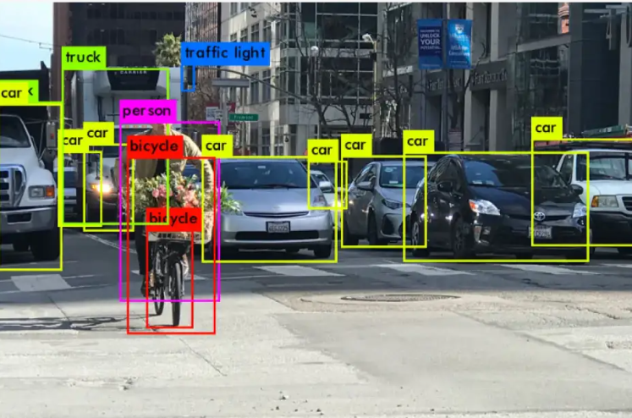






Methodology Pipeline
End-to-End Workflow
Data Preparation
Preprocessing
Model Training
Roboflow dataset & splits
OpenCV & resize operations
YOLO fine-tuning
Evaluation
Deployment
Real-Time Detection
Precision, Recall, mAP, IoU
Streamlit web app
~30 FPS performance
Iterative refinement for optimal performance

Slide 13





Training Setup
Environment & Configuration
Platform
Training Code Example
from ultralytics import YOLO
model = YOLO('yolov8m.pt') results = model.train(
data='data.yaml', epochs=50,
imgsz=640, batch=16,
device=0
Google Colab GPU Acceleration
Hyperparameters
Epochs: 50 Img Size: 640
Batch: 16 Device: 0 (GPU)
)
Consistent across all models for fair comparison
Best model saved as best.pt for deployment

Slide 14
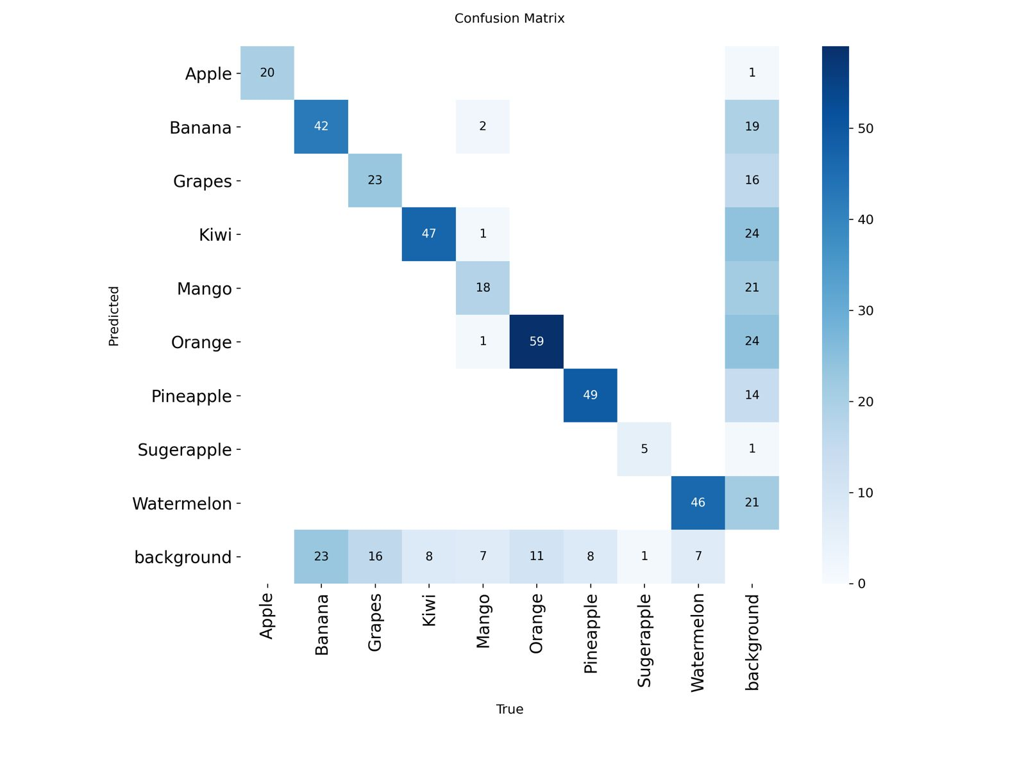




YOLOv5 Results
Training Performance
Box Loss
Decreasing
Cls Loss
Converged
DFL Loss
Stable
Confusion Matrix
Strong diagonal concentration High class separation accuracy
Minimal confusion between classes
Key Metrics
mAP@ 0.5: (See plot)
Precision: (See plot)
Recall: (See plot)
mAP@ 0.5:0.95: (See plot)

Slide 15
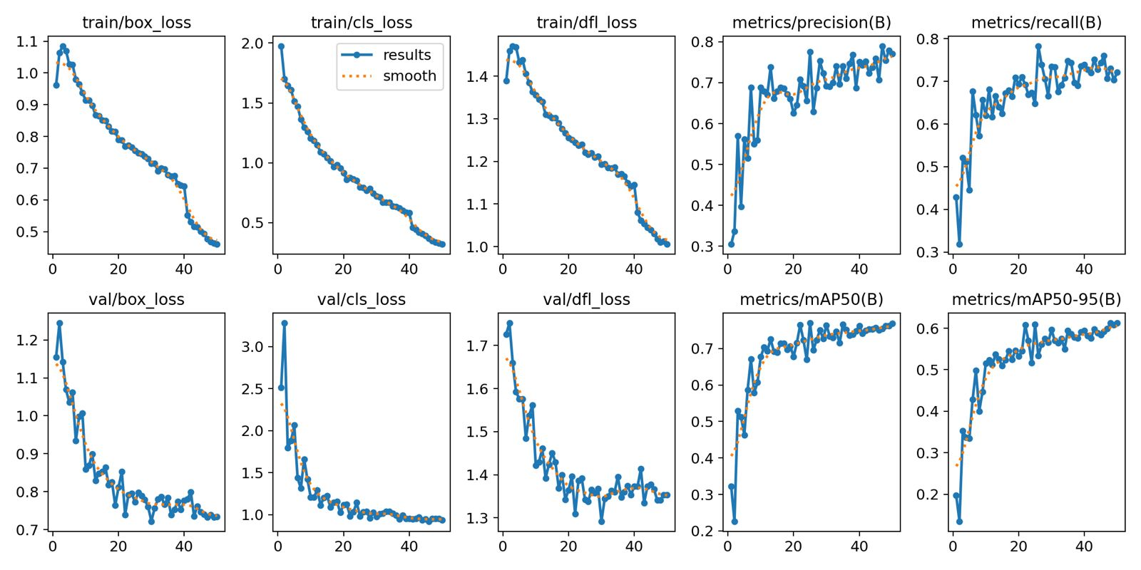
YOLOv5 Results

Slide 16
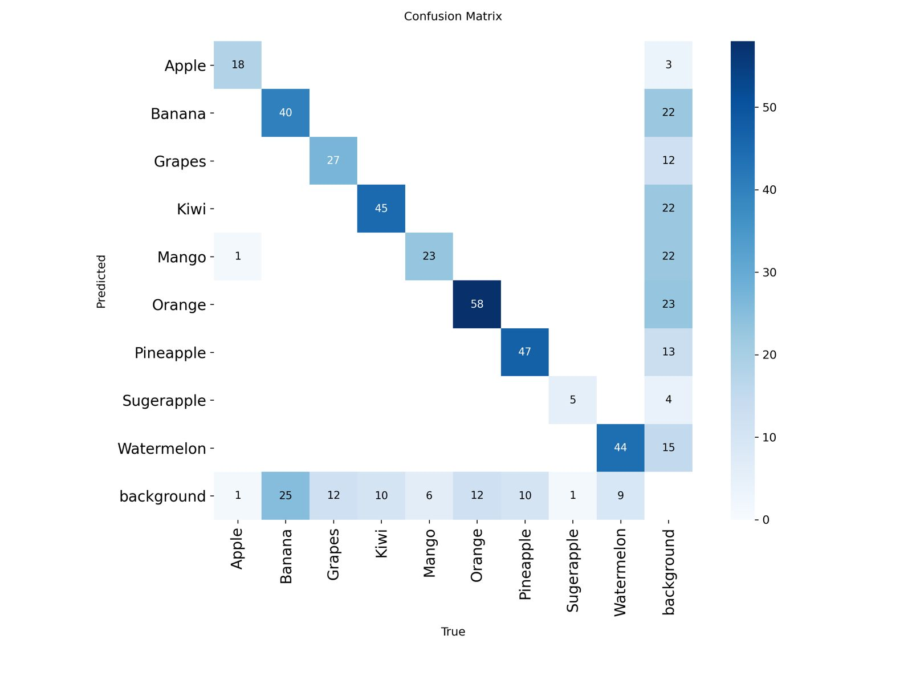




YOLOv8 Results
Training Progress
Train Loss
Decreasing
Val Loss
Decreasing
mAP
Increasing
Confusion Matrix Analysis
Strong diagonal concentration confirmed High accuracy across all fruit classes Minimal confusion between similar fruits
Performance Summary
Precision: (See plot)
Recall: (See plot)
mAP@ 0.5: (See plot)
mAP@ 0.5:0.95: (See plot)

Slide 17
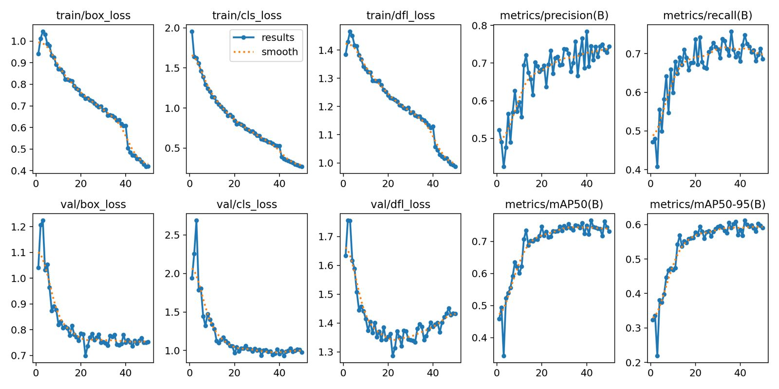
YOLOv8 Results

Slide 18
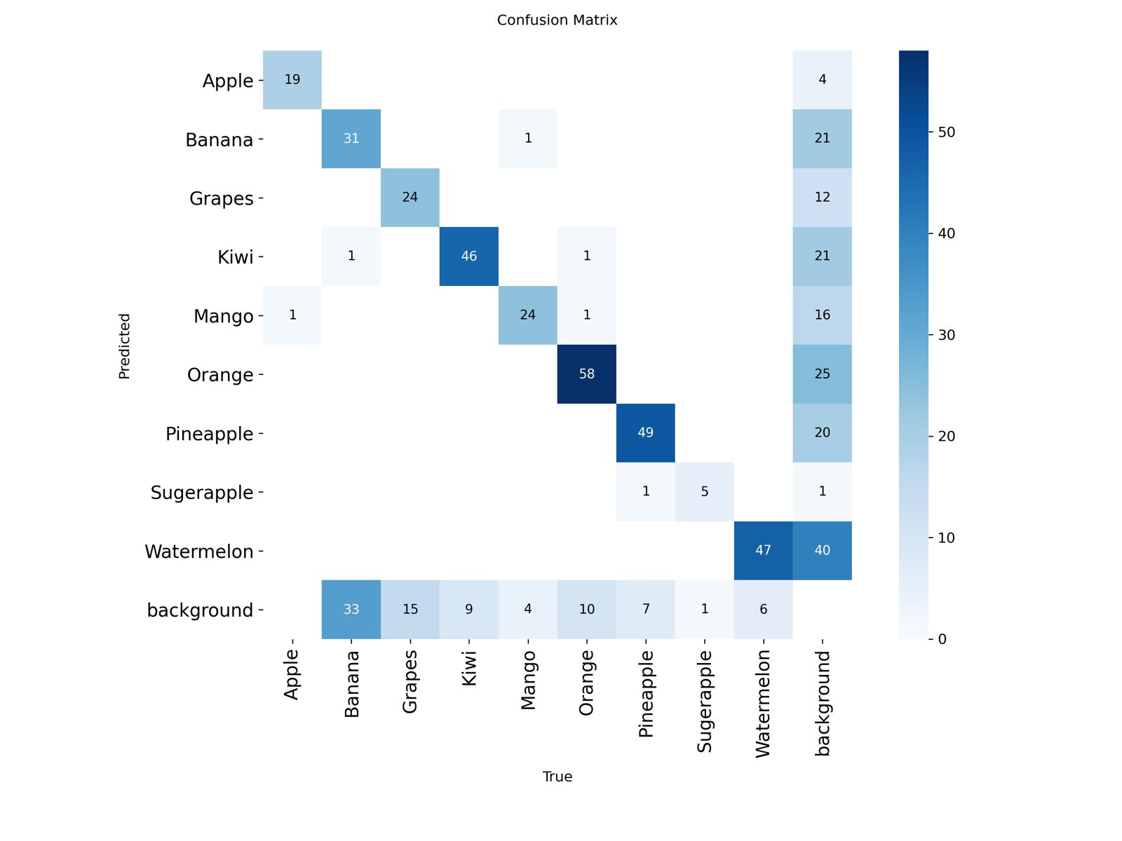




YOLOv11 Results
Training Progress
Train Loss
Rapid Drop
Val Loss
Stable
mAP
Highest
Confusion Matrix Analysis
Excellent class discrimination Strongest diagonal concentration Minimal false positives
Performance Highlights
Precision: (See plot)
Recall: (See plot)
mAP@ 0.5: (See plot)
mAP@ 0.5:0.95: (See plot)

Slide 19
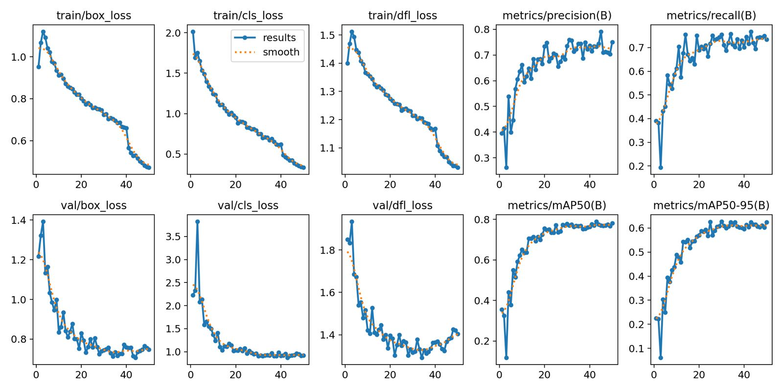
YOLOv11 Results

Slide 20






Model Comparison
Key Findings
YOLOv11m achieved highest detection accuracy
Model
Accuracy
Speed
Strength
Weakness
YOLOv5m provided fastest inference time
YOLOv5m
(From results)
Fastest
Fastest inference
Moderate
accuracy
Real-Time Performance
(From results)
Good performance
Moderate speed
Achieved FPS:
~30
YOLOv8m
Balanced
Measured on development machine
YOLOv11m
Highest
Moderate
Best accuracy
Slower than v5
Models tested under identical conditions

Slide 21
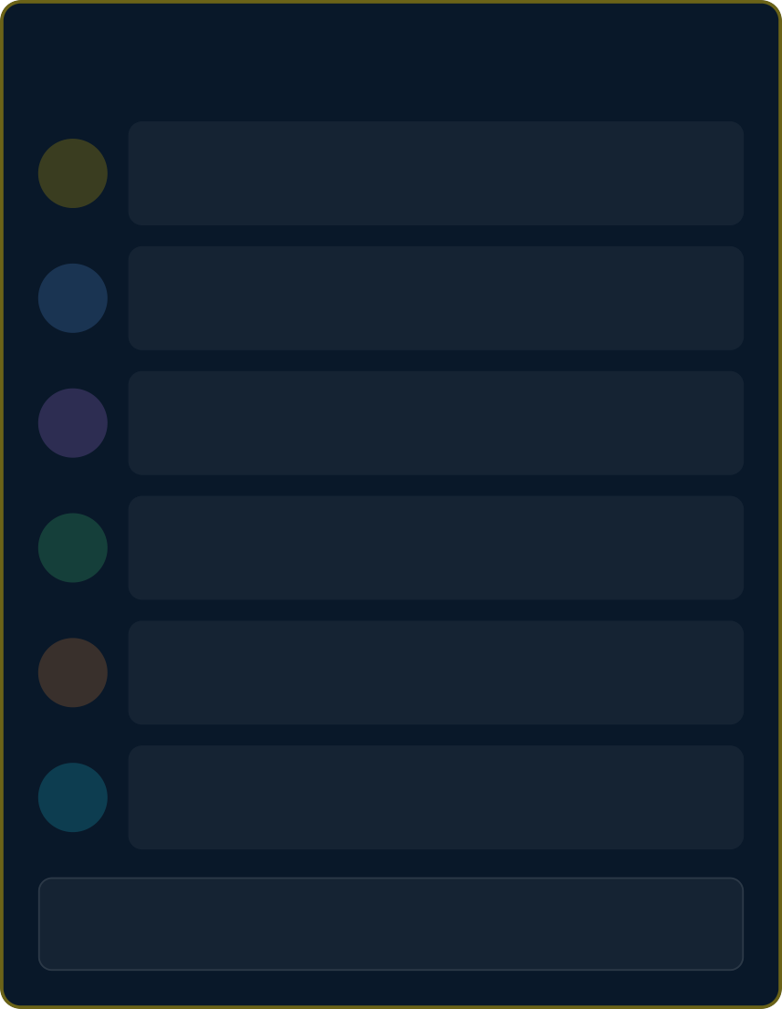















Deployment Architecture
System Pipeline
Input Sources
Webcam, Video, Images
Technology Stack
1
2
Preprocessing
OpenCV capture & resize
Python
YOLO
PyTorch
3
Inference
YOLO model detection
OpenCV
Streamlit
WebRTC
4
Postprocessing
Draw boxes & labels
User Interface
5
UI Visualization
Streamlit web app
Overview Page
Live Detection
Analytics Dashboard
Model Selection
6
Analytics Logging
Detection summary
Real-time performance: ~30 FPS
Browser-based deployment
End-to-end latency: ~32ms/frame

Slide 22
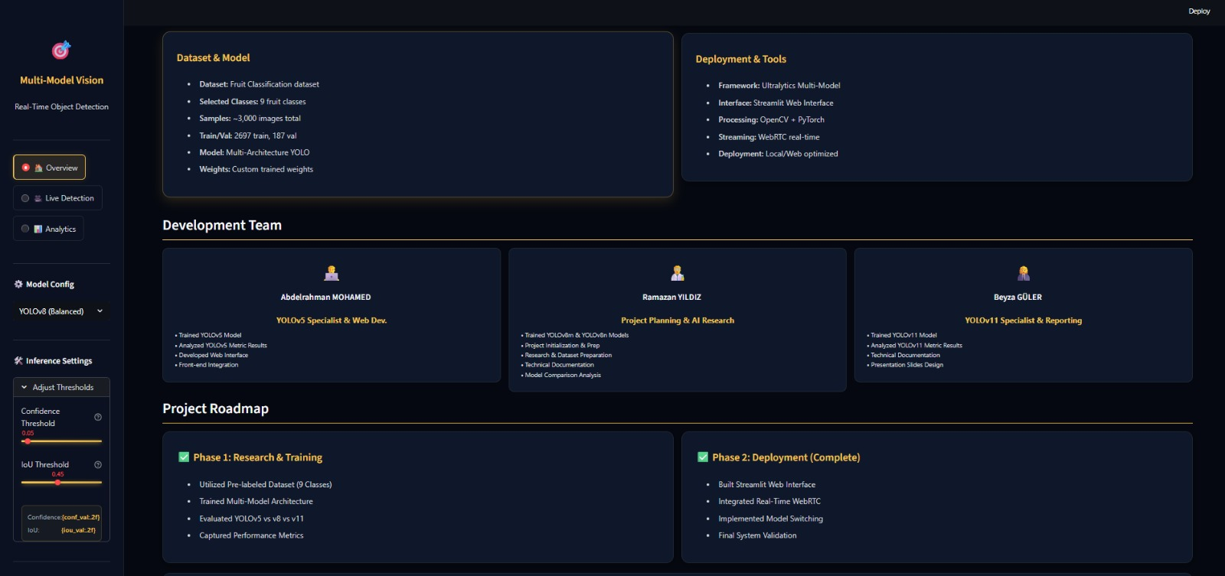
Web Application - Overview & Live Detection

Slide 23
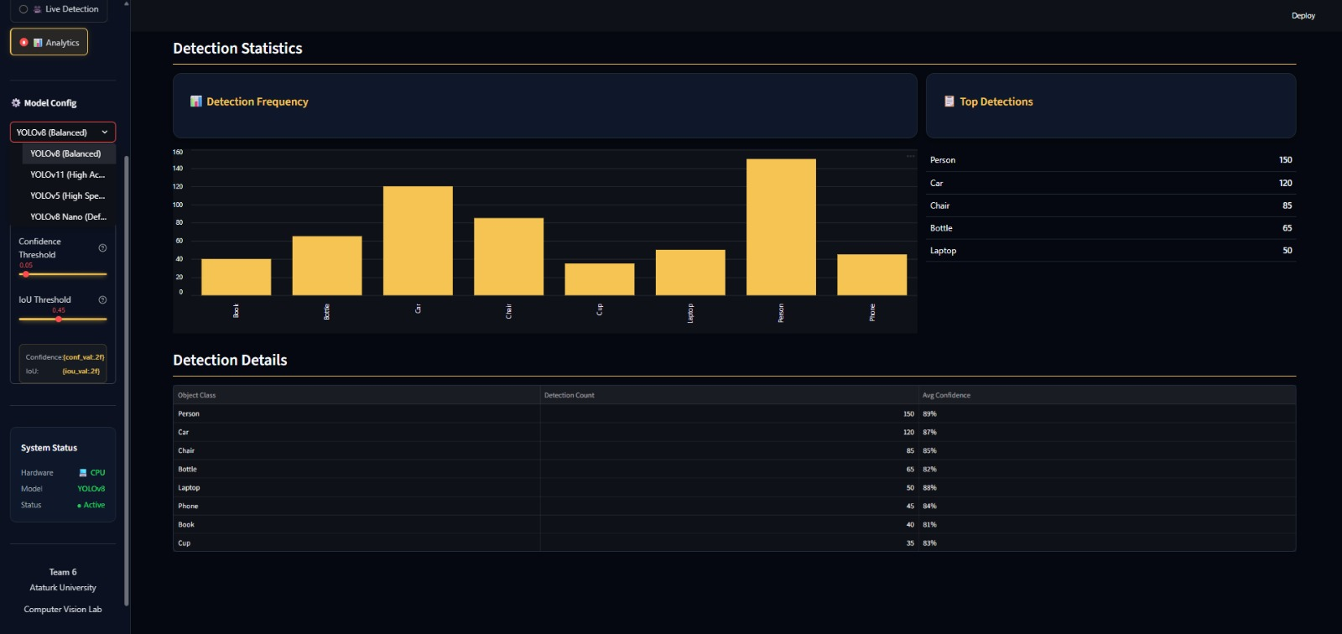
Web Application - Overview & Live Detection

Slide 24
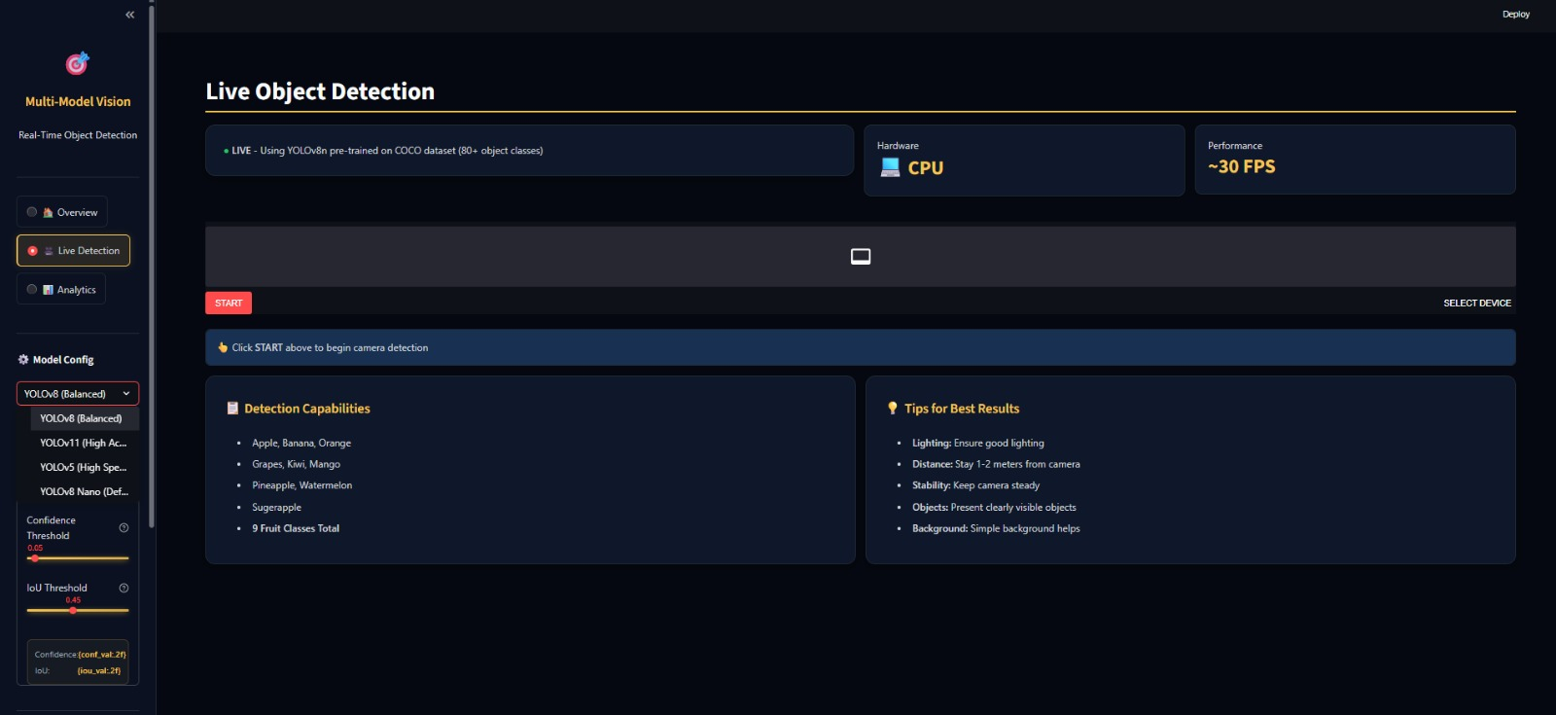
Web Application - Overview & Live Detection

Slide 25
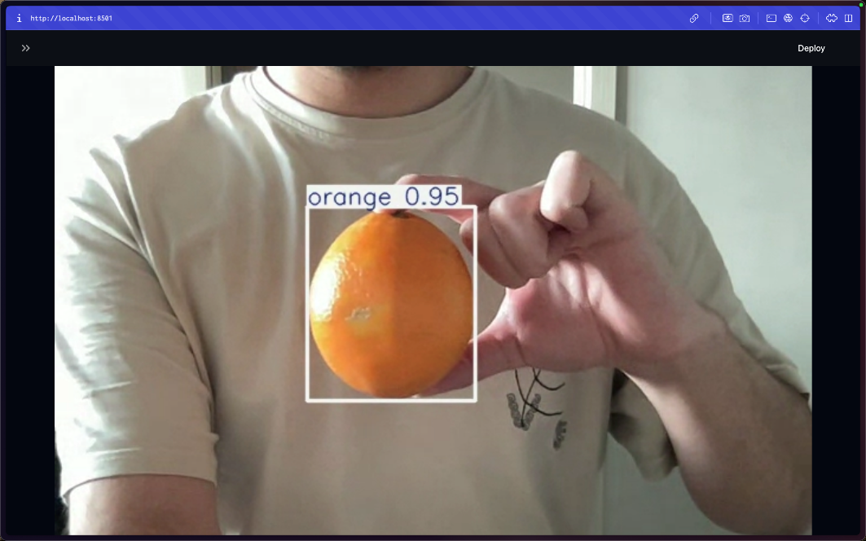
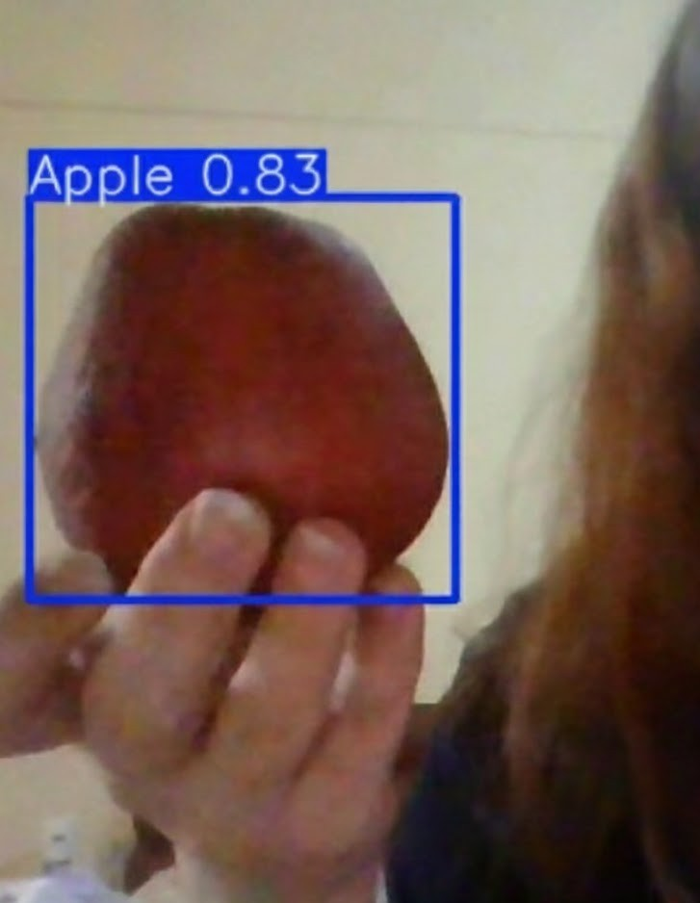
Web Application - Overview & Live Detection

Slide 26









Challenges & Limitations
Key Challenges
Accuracy vs Speed Tradeoff
Larger models more accurate but slower
Lighting & Occlusion
Detection quality varies with conditions
Small Objects & Crowds
Harder to detect in complex scenes
Current Limitations
Limited Dataset
Only 9 fruit classes, need diversity
Hardware Constraints
GPU availability & compute resources
Generalization Issues
Performance drops in unseen environments
Lab Constraints
Webcam permissions & driver compatibility

Slide 27












Backup Plan & Risk Mitigation
Model Issues
Use stable YOLOv8 or switch to YOLOv5 Alternative frameworks available
Training Instability
Reduce classes or data subset
Adjust hyperparameters (LR, batch, epochs)
Data Problems
Use additional public datasets Collect new training samples
Compute Load
Migrate to cloud GPU platform Use lighter nano model variant
Web App Issues
Alternative UI frameworks (Gradio, Dash) Core detection remains functional
Mitigation Strategy
Timeline Delays
Overlap less critical project steps Extend schedule maintaining objectives
Proactive backup measures ensure project continuity

Slide 28










Conclusion
Comprehensive Evaluation
Benchmarked 3 YOLO architectures Produced training artifacts Generated evaluation metrics
Working Prototype
Real-time object detection successfully implemented and deployed
System Integration
YOLO + OpenCV + Streamlit web application fully functional
Browser Deployment
Accessible via web browser Real-time webcam detection Analytics dashboard included
Performance Achievement
Stable real-time performance at ~30 FPS achieved
Strong foundation for future enhancements

Slide 29




Future Work
Enhanced Evaluation
Per-class AP analysis
Latency profiling
Model quantization
Rigorous benchmarking
Dataset Expansion
Larger custom dataset training
Deployment Expansion
More object classes
Mobile app deployment
Varied environmental conditions
On-device inference
Edge computing optimization
Advanced Features
3D localization & depth estimation
UI Improvements
Multi-object tracking
Model switcher
Threshold controls
Instance segmentation
Save results feature
Session logs

Slide 30



Thank You
Thank You For Your Attention!
Questions & Answers

